Slide 1


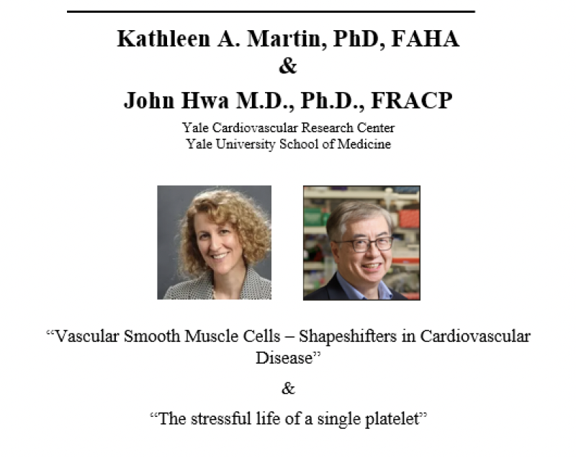
Center for Advanced Studies and Technology
University «G. d’Annunzio», Chieti-Pescara
Conference Hall, Tuesday, September 15, 2026, 2:00 PM

