Slide 1
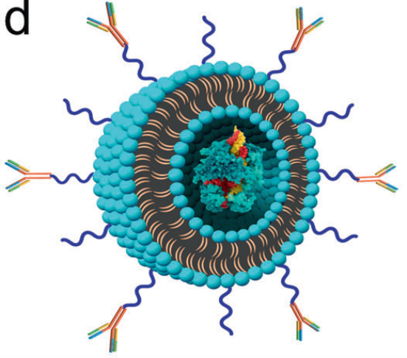
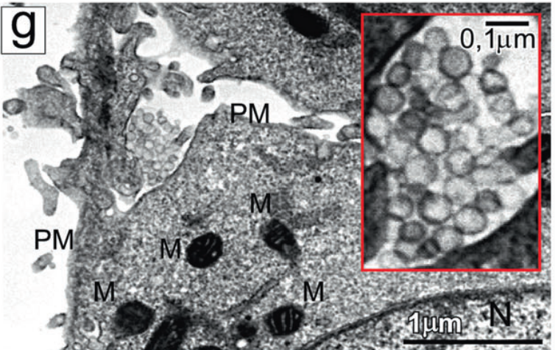
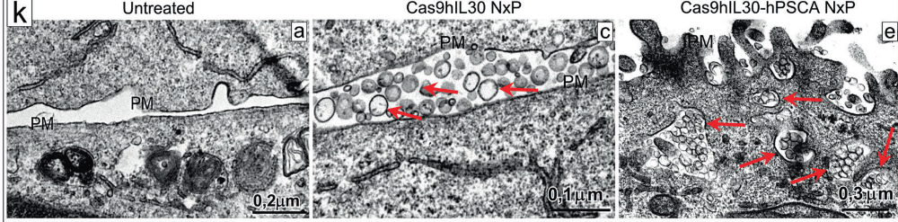
Il rilascio mirato del complesso CRISPR/Cas9-gRNA-IL30 mediante immunoliposomi inibisce il cancro alla prostata e prolunga la sopravvivenza
Specific binding and uptake of nanoliposomes conjugated with anti-hPSCA Ab by tumor cells.
Immunoliposome containing the CRISPR/Cas9gRNA-hIL30 complex and functionalized with anti-hPSCA Abs
Ultrastructural features of DU145 cells that were not treated (a) or treated with Cas9hIL30 NxPs (c) or Cas9hIL30-hPSCA NxPs (e).

Slide 2
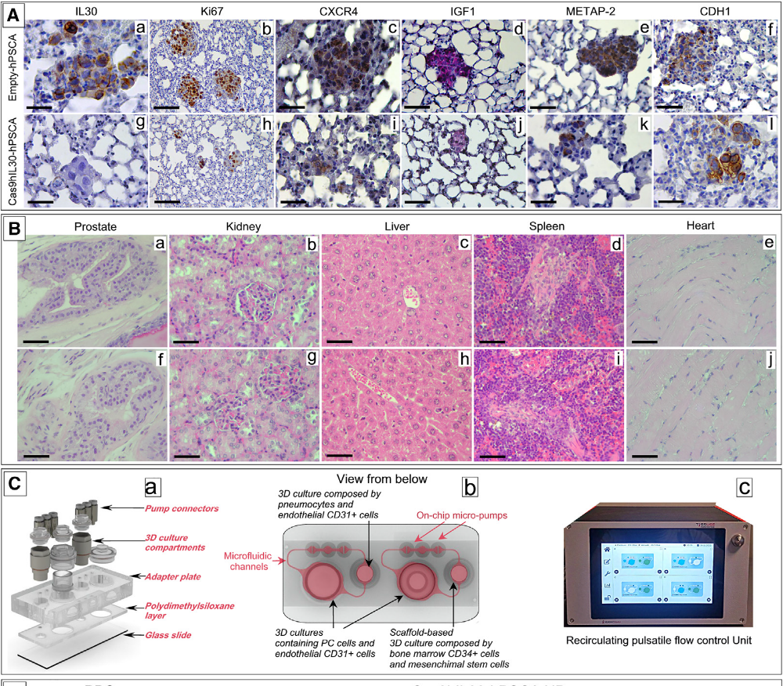
Il rilascio tramite immunoliposomi di CRISPR-Cas9 diretto contro IL30 in cellule PSCA+ PC diffuse attraverso la circolazione polmonare ne inibisce efficacemente la metastatizzazione
(A) Lung metastasis, developed after i.v. inoculation of DU145 cells, from empty-hPSCA NP-treated mice express IL-30 (a) show a robust proliferation (b), strong expression of CXCR4 (c), IGF1 (d), METAP-2 (e), and weak CDH1 expression (f). By contrast, the few metastases developed in Cas9hIL30-PSCA NP-treated animals lack IL-30 expression (g) and show a low cancer cell proliferation (h) and a weak expression of CXCR4 (i), IGF1 (j), and METAP-2 (k), while the expression of CDH1 was strengthened (l).
(B) The prostate, liver, kidneys, spleen, and heart of NSG mice bearing DU145 tumor microemboli in their lungs, and then treated with Cas9hIL30-PSCA NPs (a–e), are free of signs of tissue or cell damage, and their histologic features are fully comparable with that of organs of NSG mice treated with empty-hPSCA NPs (f–j)
(C) Microfluidic bioreactor, HUMIMIC Chip2 (a), which housed in one compartment the spheroid co-culture of PC and endothelial cells, (b) interconnected, via microfluidic channels, to a second compartment containing 3D spheroid co-culture of pneumocytes and endothelial cells, to mimic the lung, or a ceramic scaffold, comprising BM-derived MSCs and CD34+ MSCs, to mimic the BM niche. Micropumps, generating a pulsatile flow, adjusted by a control unit (c), ensured the dynamic circulation, between the two compartments of the culture medium.

Slide 3
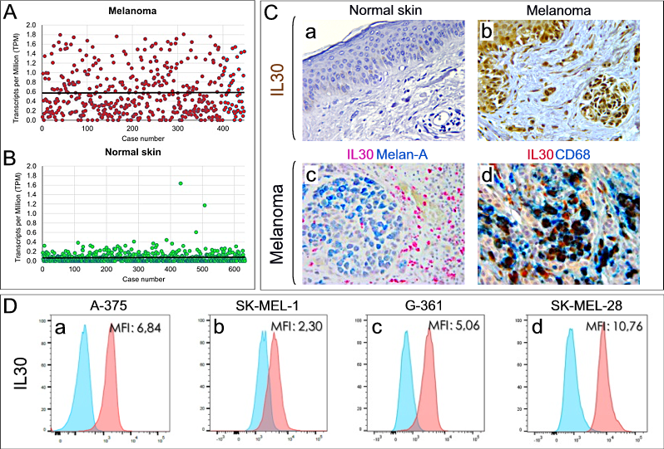
IL30 is expressed in melanomas by immune and neoplastic cells
and promotes cancer cell proliferation and migration
and B. Scatter plots show IL30 expression levels in melanoma (A) versus normal skin (B) samples. Expression data were retrieved from the TCGA-SKCM dataset (n = 447) for melanoma, and the GTEx dataset (n = 633) for normal skin. To minimize the impact of extreme values, outlier samples were excluded. The horizontal line indicates the mean expression value for each group.
Immunohistochemistry shows that IL30 is undetectable in normal skin (a), whereas it is expressed in melanoma samples by cancer and mostly by infiltrating immune cells (b), as confirmed by Melan-A/IL30 double staining (c), and especially by CD68⁺ macrophages (d). Magnification: a, b, c X400; d, X630.

Slide 4
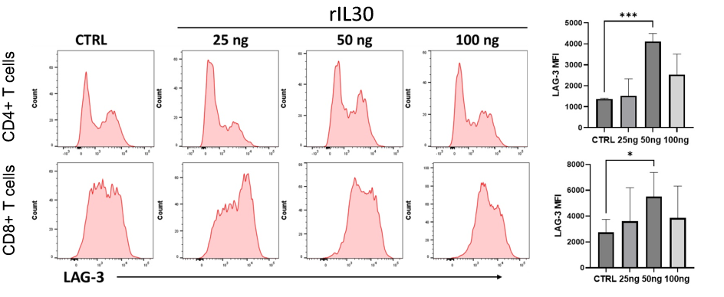
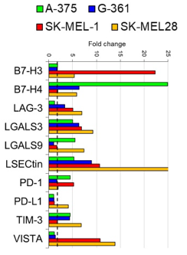
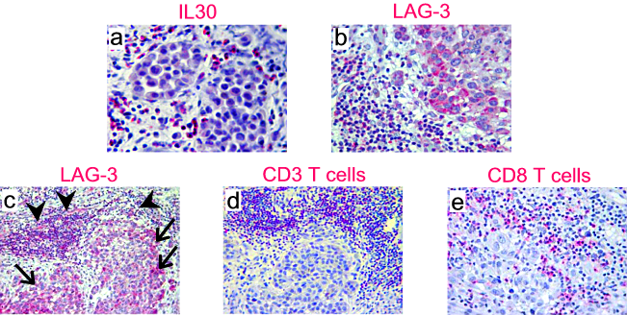
L'IL30 sopprime l'attivazione e l'espansione dei linfociti T e potenzia l'espressione di molecole di checkpoint immunitario sia nelle cellule T che nelle cellule di melanoma
Cytofluorimetric analysis of LAG-3 expression in CD4⁺ (top) and CD8⁺ (bottom) T cells, from healthy individuals, untreated (CTRL) or treated with different concentrations of rIL30. Bar graphs on the right summarize the MFI values from three independent experiments. A significant increase in LAG-3 expression (ANOVA: p<0.001) was observed in CD4⁺ T cells treated with 50 ng/ml of rIL30 compared to CTRL (***p<0.001, Tukey HSD test) (top-right), and in CD8⁺ T cells treated with 50 ng/ml of rIL30 compared to CTRL (*p<0.05, Tukey HSD test) (bottom-right).
Fold changes in mRNA expression levels of immune checkpoint molecules between rIL30-treated and untreated melanoma cell lines. The dashed line represents the two-fold change cutoff. A two-fold change in gene expression was considered significant at p<0.001.
Immunohistochemistry shows that IL30 expression (a), which localises in melanoma cells and infiltrating immune cells, correlates with LAG-3 expression (b, c), which can be found (c) in melanoma cells (arrows) and in infiltrating immune cells (arrowheads), identifiable with CD3⁺ (d), mostly CD8⁺ T lymphocytes (e). Magnification: a, b, e X400; c, d, X200.

Slide 5
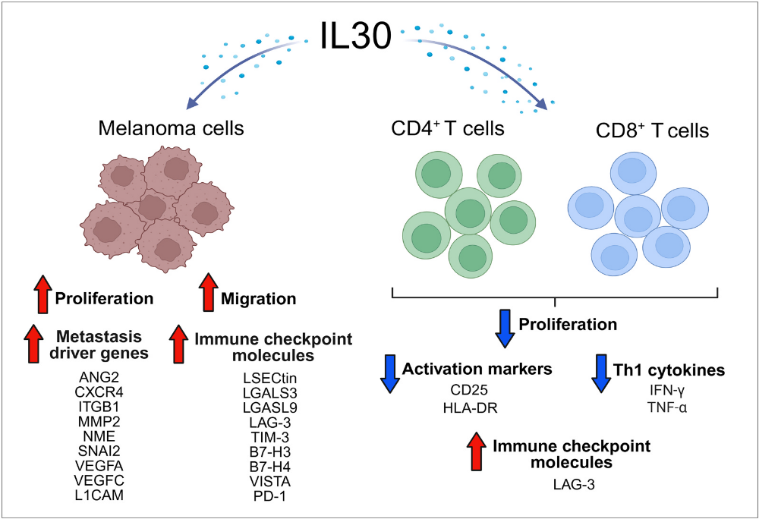



L'IL30 riprogramma l’espressione genica del melanoma promuovendone la metastatizzazione e frena la risposta immune antitumorale dei linfociti T
I dati indicano il gene dell’IL30 come potenziale bersaglio terapeutico nel melanoma metastatico.
Il suo silenziamento mediante nanovettori ed editing genetico potrebbe ridurre le metastasi e potenziare la risposta alla immunoterapia combinata (Opdualag®) con nivolumab (anticorpo anti-PD-1) e relatlimab (anticorpo anti-LAG-3).
Sono in corso studi preclinici per valutarne efficacia, sicurezza e biodistribuzione.
Interleukin-30 promotes melanoma spreading and triggers LAG-3 expression and T cell exhaustion
B i o m e d ic i n e & P h a r m a c o t h e r a p y 197 (2026) 119183

