Slide 1


A new magnetometer for biomagnetism
Stefania Della Penna
ITAB-DNISC University of Chieti-Pescara
OXiNEMS Co-investigator
Contact: info@oxinems.eu
This project has received funding from the European Union’s Horizon 2020 research and innovation programme under grant agreement N.828784
WWW.OXINEMS.EU

Slide 2
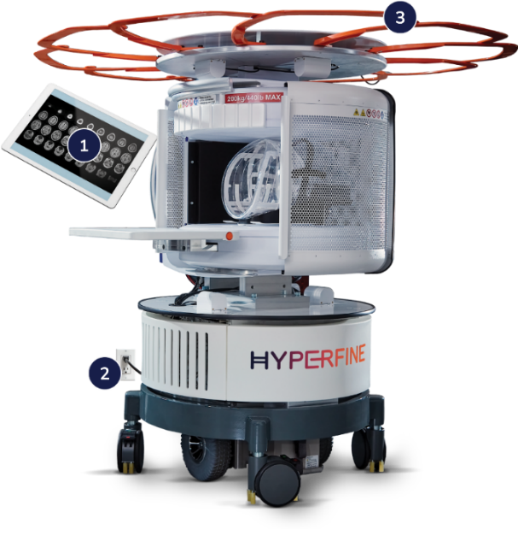
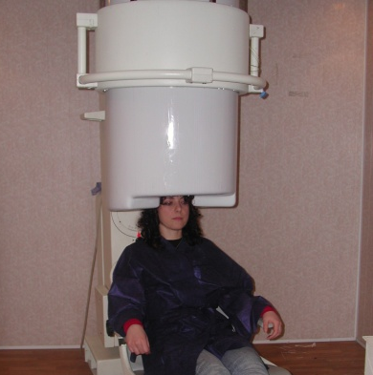
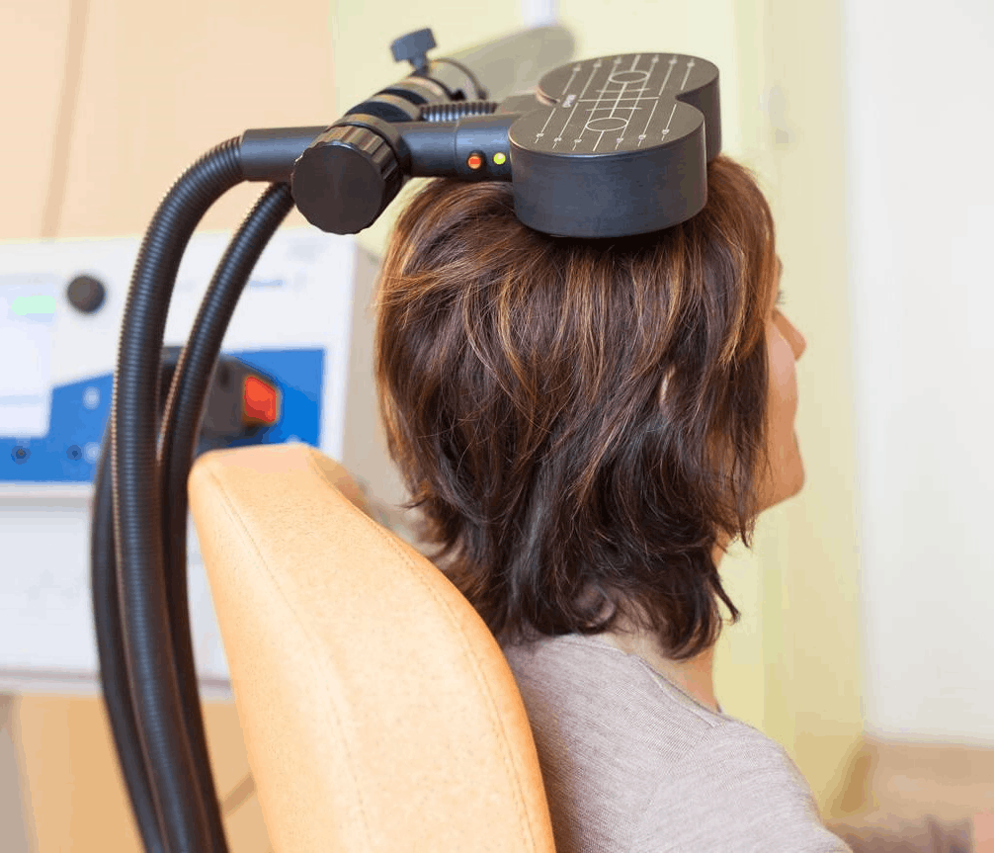
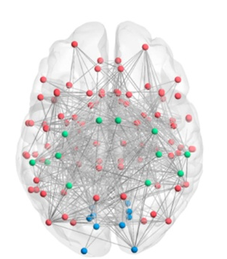


NEEDS
MEG
=
High spatial and temporal resolution localization
Improved presurgical mapping
MRI
Swoop by Hyperfine
TMS
=
High spatial resolution neuromodulation of dysfunctional networks (e.g. schizophrenia, depression)
Time resolved activity
Time resolved connectivity
www.oxinems.eu
A new magnetometer for biomagnetism
Confidential – for EIC T2M event use only

Slide 3
PROBLEM
MEG
MEG/MRI
MEG/TMS
MRI
TMS
Do you know that it is not possible to simultaneously run TMS/MRI with MEG?
The high fields of this technique would disrupt the SQUIDs MEG devices !!! → This prevents bringing TMS/MRI with MEG to the clinical world
www.oxinems.eu
A new magnetometer for biomagnetism
Confidential – for EIC T2M event use only

Slide 4
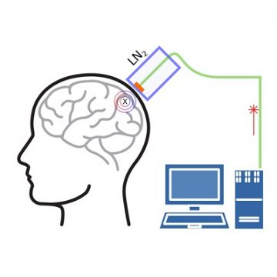

SOLUTION
We propose a new device for MEG, to build novel systems for integrated multimodal imaging!
Superconducting loop working in liquid nitrogen + Magnetic Nano-Electro-Mechanical Sensor with optical readout
Patent granted both in USA (US11415642B2) and in Europe (EP3896470B1, validated in UK and as Unitary Patent)
OUR UVP: Stands large applied magnetic fields
www.oxinems.eu
A new magnetometer for biomagnetism
Confidential – for EIC T2M event use only

Slide 5

MARKET SIZE
MEG market is steadily growing. There are actually 6 major companies involved in MEG instrumentation. Three of these are less than 8 years old, thanks to new interest in MEG systems.
MUS$
year
European compound annual growth rate from 2023 to 2028
5.8%
www.oxinems.eu
A new magnetometer for biomagnetism
Confidential – for EIC T2M event use only

Slide 6
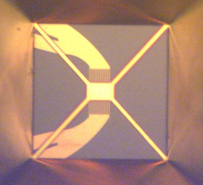
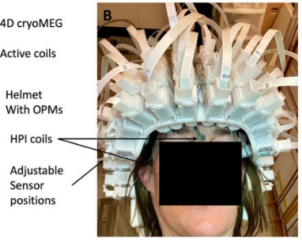
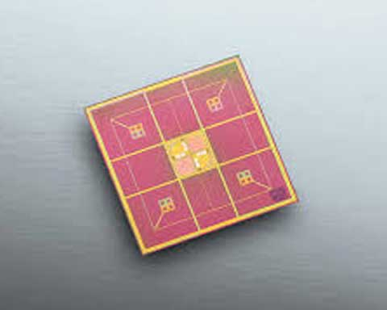
COMPETITIONS
Field Tolerance | Spatial resolution | Maintenance cost (per week)
yes | Very good (estimated < 5 mm) | < 100 €
no | Moderate (5-7 mm) | None
moderate fields | Good (5 mm) | > 500 € at best
OXiNEMS biomagnetic channel
OPM and HTc SQUIDs
Complex design of LTc SQUIDs
www.oxinems.eu
A new magnetometer for biomagnetism
Confidential – for EIC T2M event use only

Slide 7
OUR ROADMAP
2019
2024
2025
2026
2027
2028
MILESTONES
Towards a channel for MEG systems
FET-Open Team building
1st Prototype
Fundings
SPIN off
II funding round to go to market
concepts formulation
TRL 2/3
TRL 4
Scientific Papers, new patents
www.oxinems.eu
A new magnetometer for biomagnetism
Confidential – for EIC T2M event use only

Slide 8
CALL FOR ACTION
JOIN US AS A PARTNER OF NEW PROJECTS
Human resources (scientists+business developer)
Support/collaboration
Funding (∼2 M€)
WE NEED
contacts: info@oxinems.eu
www.oxinems.eu
A new magnetometer for biomagnetism
Confidential – for EIC T2M event use only

Slide 9
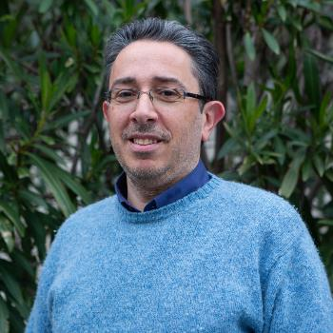
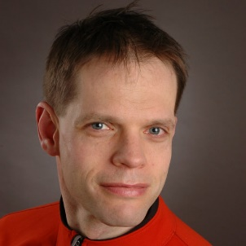
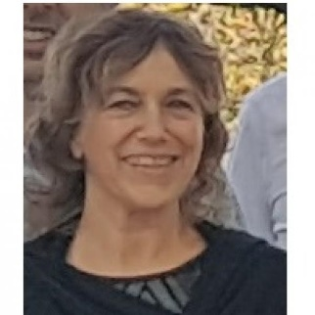
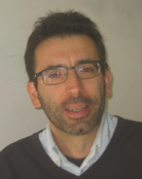
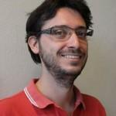

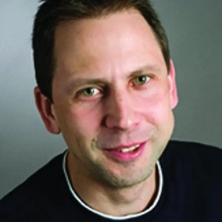
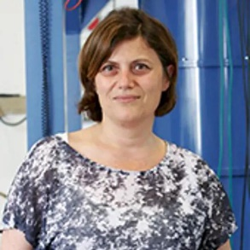





TEAM
Daniele Marrè
Alexander Schwarz
Stefania Della Penna
Luca Pellegrino
Nicola Manca
Warner Venstra
Alexei Kalaboukhov
Floriana Lombardi
Optomechanical readout
Design, fabrication, test and optimization of MEMS/NEMS
Biomagnetic Instrumention design,
Methods for signal analysis
Device microfabrication
Optomechanical methods
www.oxinems.eu
A new magnetometer for biomagnetism
Confidential – for EIC T2M event use only

